Slide 1
HackHeist @ Princeton University
4see

Slide 2


Slide 3
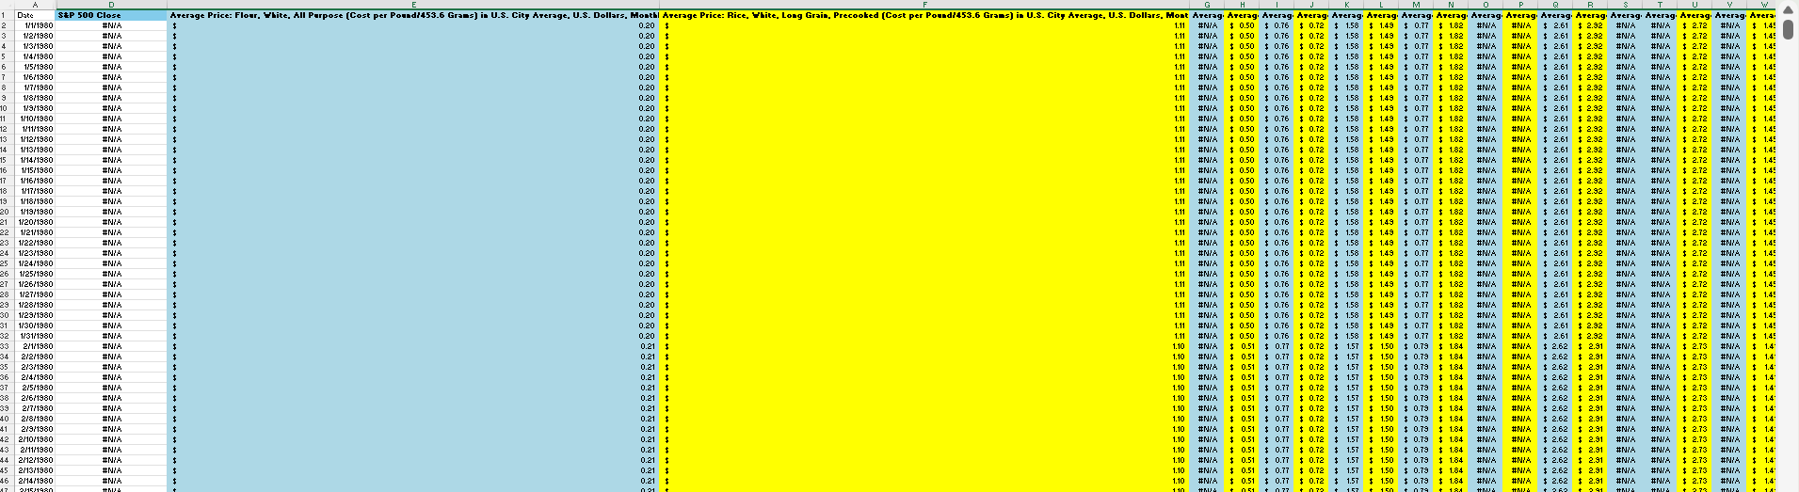

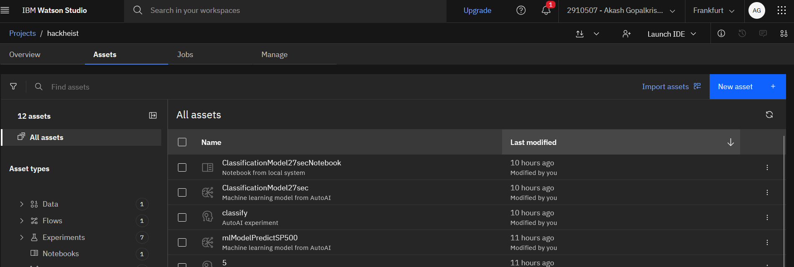
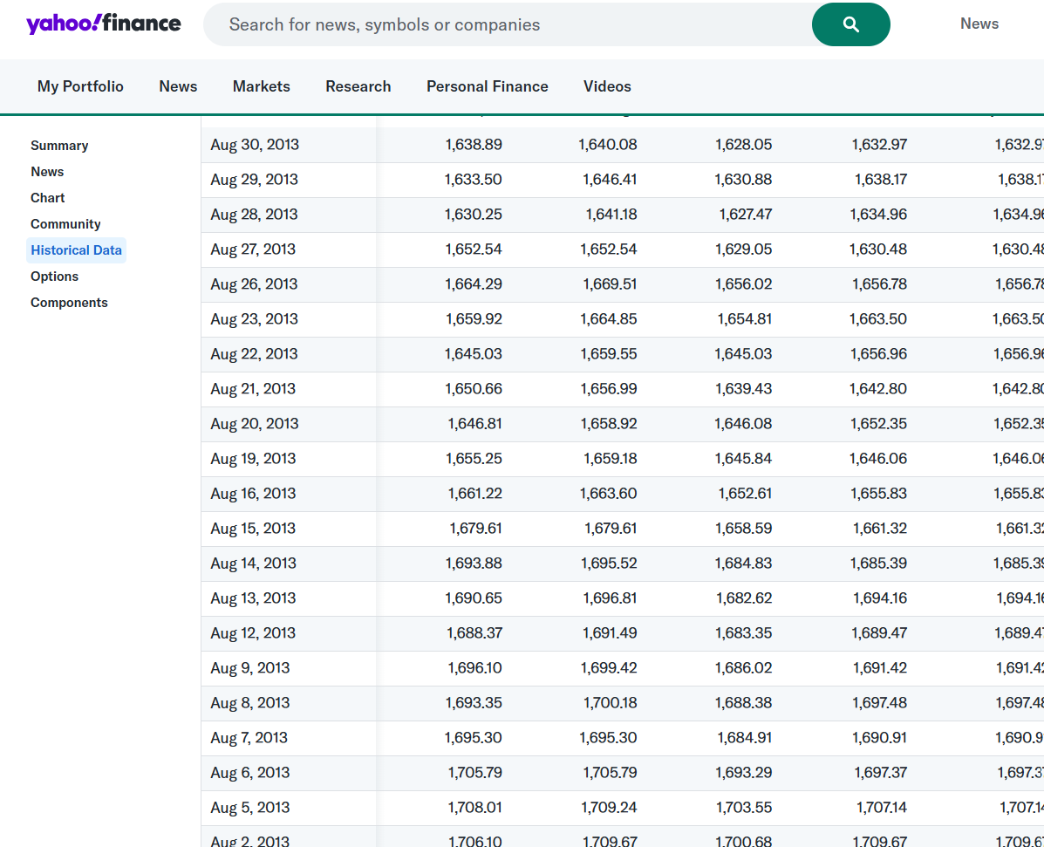
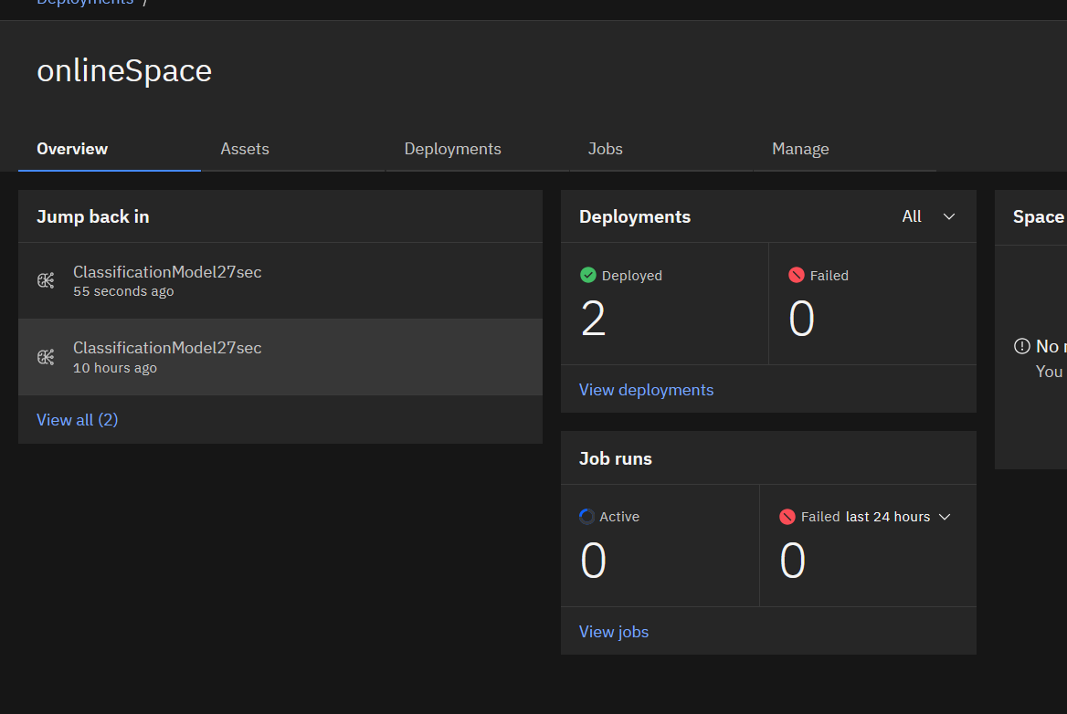
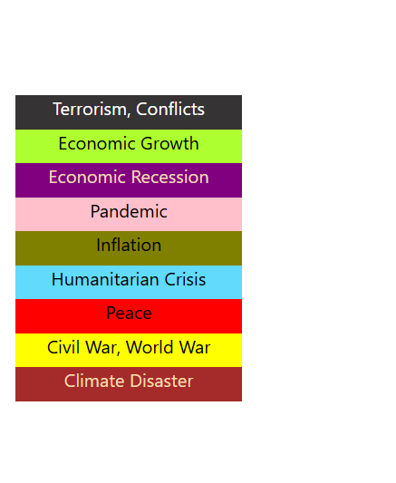

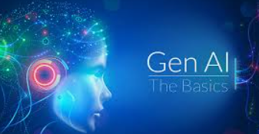

Slide 4
Finance track, DEI+Fintech
Problems:
Very high price wall for financial api and quant trading is very esoteric.
Even if you have the knowledge, you need high computing power, reliable internet
DEI – those not able to get the knowledge due to DEI obstacles

Slide 5
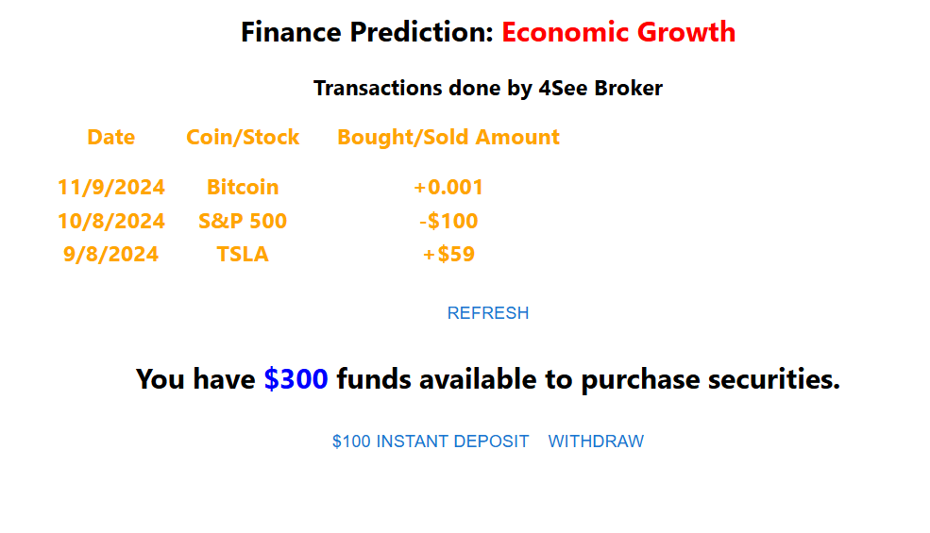
Fintech, DEI solution – like a free trading bot that works!!
Solution – Gen AI model uses continuous learning to crunch the data based on Price Wars Theory and predict events, thereby allowing ANYONE allow the AI to trade for them on their behalf.
All you need is a cellphone and connection to a cell tower.
The model is deployed and read from the cloud.
Hopefully I can make the data source open-source so that people will contribute the financial data that is used in training the model.

Slide 6
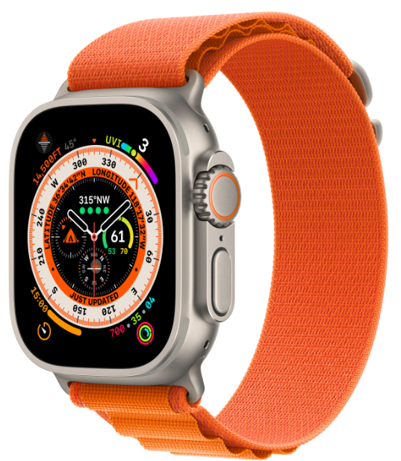
Medical Uses too
Collect bio-information like sleep patterns, thoughts, feelings, brain states, habits, using wearable device
Use Gen AI to create ML model from data, plus aggregated financial data so that model learns habit patterns of user and correlates habits with feelings and thoughts.
Then this allows you to diagnose what caused an illness – obviously what you think and feel guides our actions, actions lead to illness or wrong choices, bad habits that lead to illness. Help stymie the development of bad habits by differentiating “good” and “bad” feelings and thoughts.

Slide 7
Just the decoding of brain waves for feelings and thoughts
Use for the symptom simulation for patient safety and bgb schizophrenia.
This technology I have the prototype in concept – didn’t have the right hardware to implement.

Slide 8
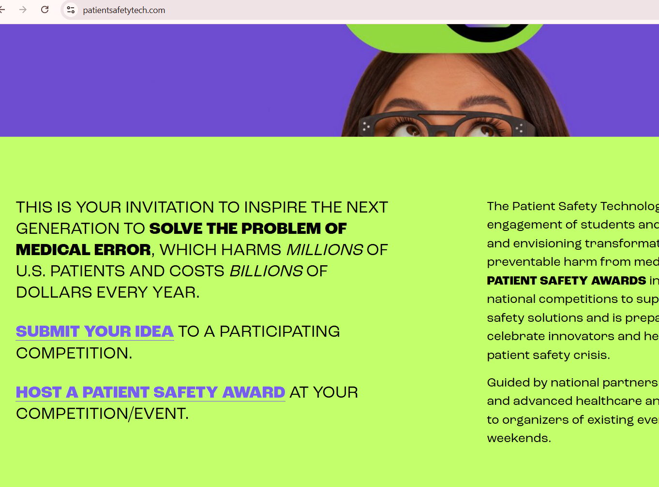
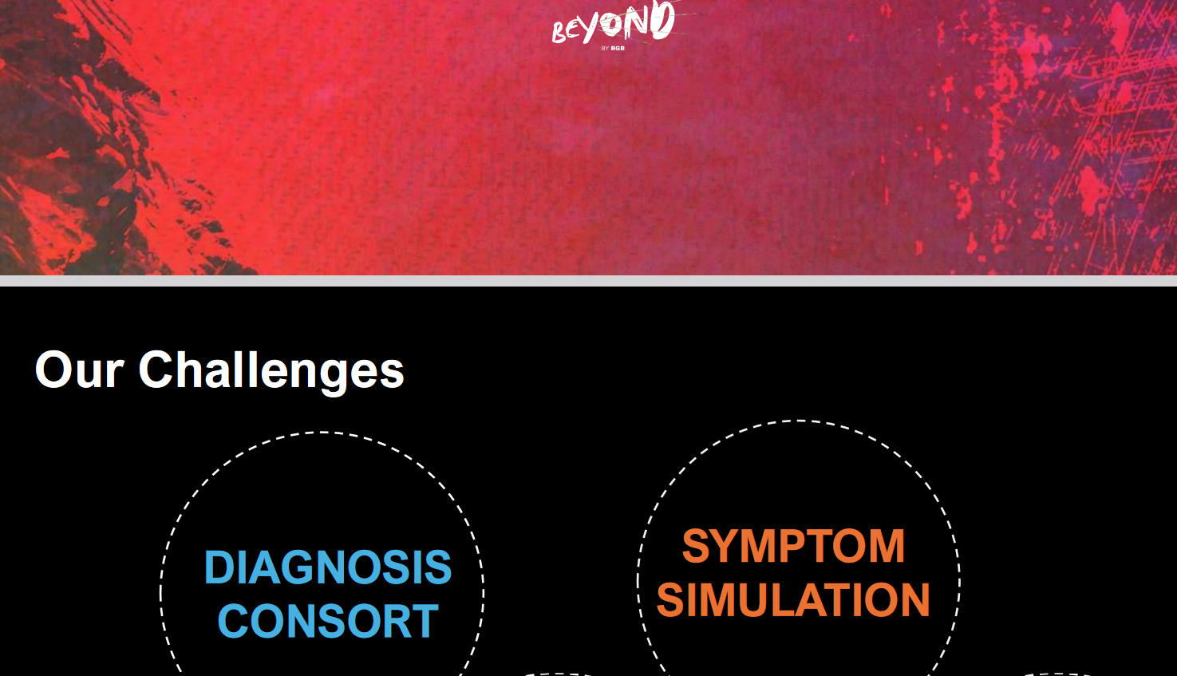
Patient safety
PRE CARE – ERROR CAUSED BY NOT UNDERSTANDING HOW TO HELP DUE TO OBSTACLES LIKE UNABLE TO EXPLAIN, ERRORS IN DEALING WITH PATIENT SAFETY
Bgb
2 companies.
2 problems.
1 solution.
Symptom simulation in Schizophrenia patients

Slide 9
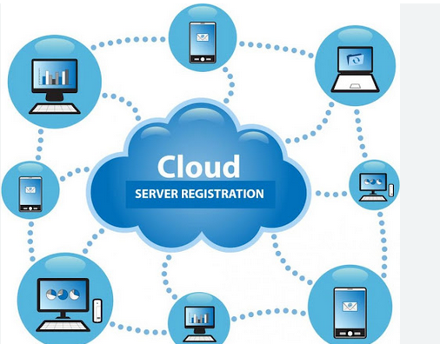
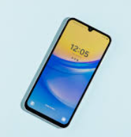
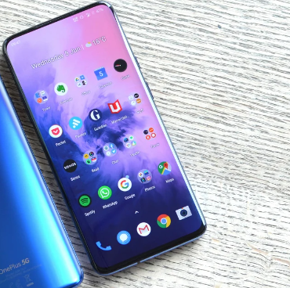
Person 1
Send digitized waves to cloud using cell tower data for data processing
Person 2 “inject” feelings and thoughts of person 1 into person 2
Ultralow frequency device located near the body to decode brain waves into digital code – send data to cellphone

